Slide 1

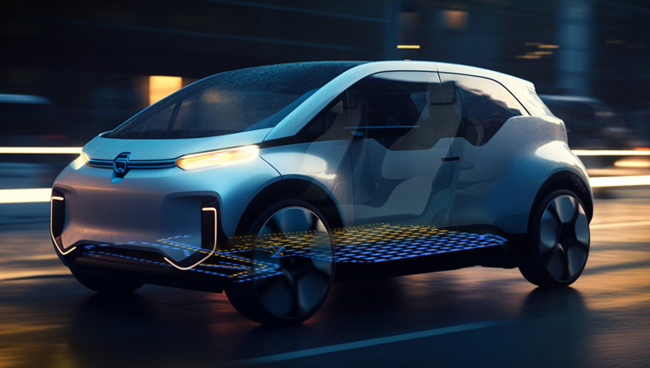

Automotive Radar
GET BATCH 2 AM ADAS

Slide 2
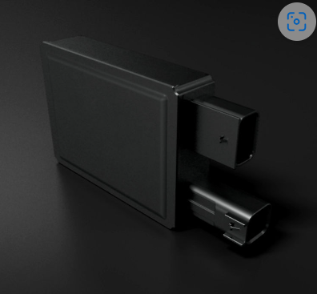
Table of contents
01
02
03
04
05
06
Intro
ADAS and AD
Basics of Radar
Radar signal processing 1
RADAR
Radar signal processing 2
TECHNOLOGY
Radar Data Processing

Slide 3
ADAS ( Advanced Driver Assistance Systems)
It is the term used for systems which assist / help drivers to increase the safety of the passengers , drivers and other road users while driving the vehicle. (say, car, Truck, etc)
How does ADAS Work?
By providing visual Information
By providing visual and/or audio warning in case of danger situation
By interfering the vehicle motion
Example :
Adaptive Cruise Control (ACC)
Rear Cross Traffic Alert (RCTA) System
Vehicle Exit Alert System
Automatic Parking
Traffic Sign recognition

Slide 4
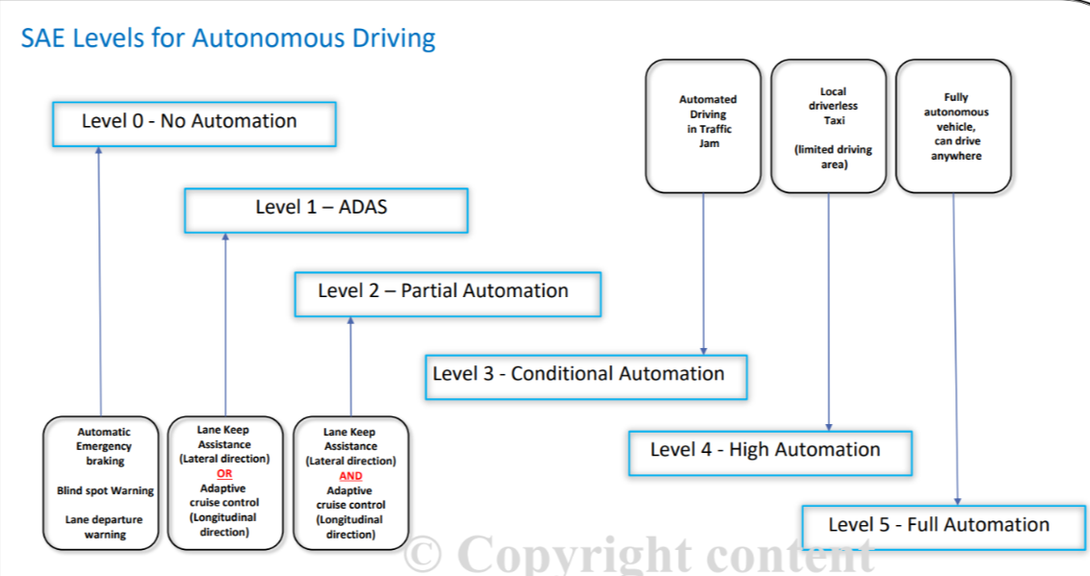
Levels

Slide 5
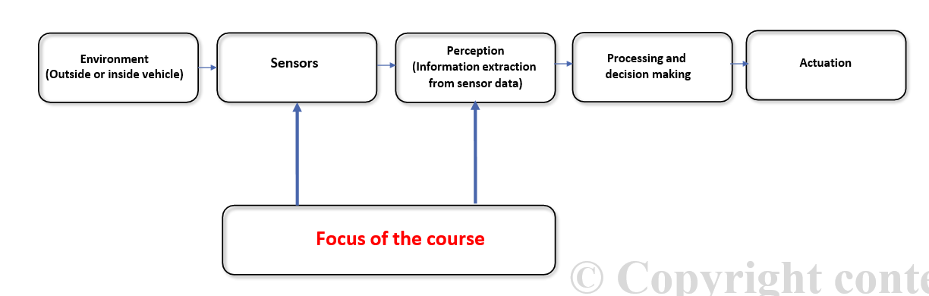
General Working of ADAS and AD
Both ADAS (Advanced Driver Assistance Systems) and AD (Autonomous Driving) systems are kind of Automation systems having different levels of Autonomy.
All these systems can be in generally described using below block diagram.

Slide 6
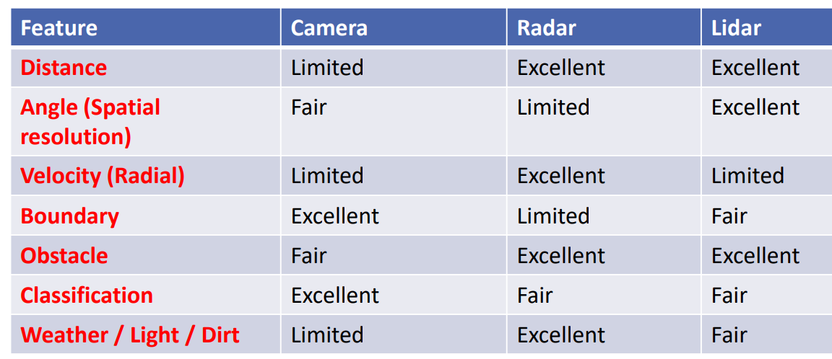
Sensors in ADAS
There are 2 types of sensors:-
Exteroceptive Sensors:-(Camera, LIDAR,RADAR, etc)
Proprioceptive Sensor:-(GPS, IMU, ENCODERS, etc)
Advantage of Radar over other sensor :

Slide 7
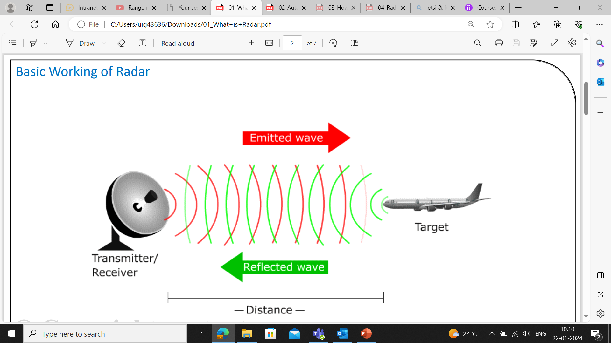
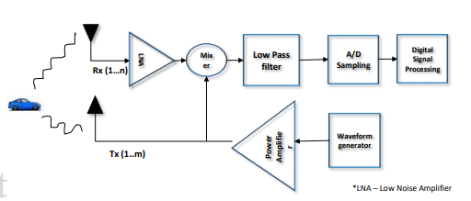
Radar
Radio – uses Electromagnetic waves in Radio spectrum
Detection – detect Objects/targets like plane, car, pedestrian, etc
Ranging – calculates the range (distance) of the target from sensor
Basic working of Radar
Radar is used to collect the information related to the object or target by radiating electromagnetic energy and examining the echo received from the distant object.

Slide 8
Classification of Radar
Based on Signal processing
Based on Applications
Primary
Secondary
Surveillance
Tracking Radar
Imaging Radar
Meteorological Radar
Automotive
Radar altimetry
CW
Pulse
Air Traffic
Air Defence
Unmodulated
Doppler
Modulated
MIT

Slide 9
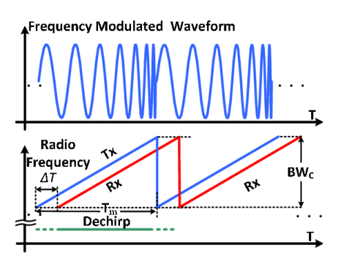
Automotive Radar
Automotive radars serve the purpose of identifying the speed and distance of objects in the surrounding area of the vehicle.
Short Range Radar (50m)
Medium Range Radar (80 – 100m)
Long Range Radar (250 – 300m)
Why FMCW?
Continuity of Measurement
Range Resolution
Maximum Range Requirement
Power requirement

Slide 10
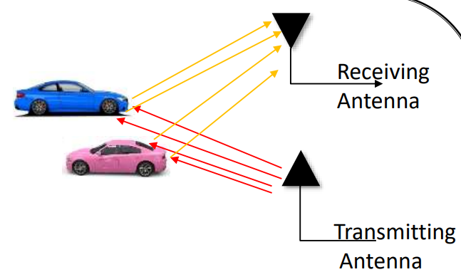
Automotive Radar Measurement
A point reflection of electromagnetic wave from the object.
Detection points :
Range
Azimuth
Elevation Angle
Doppler Speed
RCS (Radar Cross Section)
Probability of detection Pd: The Pd probability that the receiver output exceeds the threshold and the target is present.
Probability of missing Pm: The probability that the received voltage is below the threshold but the target is present.
Probability of false alarm Pf : The probability that the received voltage exceeds the threshold but the target is not present.

Slide 11
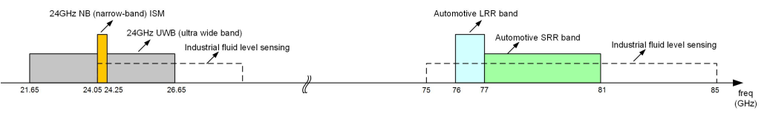
From 24 GHz to 77 GHz in Automotive Radar
For short-range radar, the 24 GHz NB and UWB bands have been in use in legacy automotive sensors.
Due to spectrum regulations and standards developed by the European Telecommunications Standards Institute (ETSI) and the Federal Communications Commission (FCC), the UWB of 24GHz can`t be used in Automotive Industry.
High Bandwidth leads to high range resolution of the Radar Sensor. Hence Frequency of 77 GHz.
76 GHz - 77 GHz -> for Long Range Radar Applications, Adaptive Cruise Control, Collision avoidance, etc.
77 GHz – 81 GHz -> for SRR and MRR Applications, Blind spot detection, Rear cross traffic alert, etc.

Slide 12
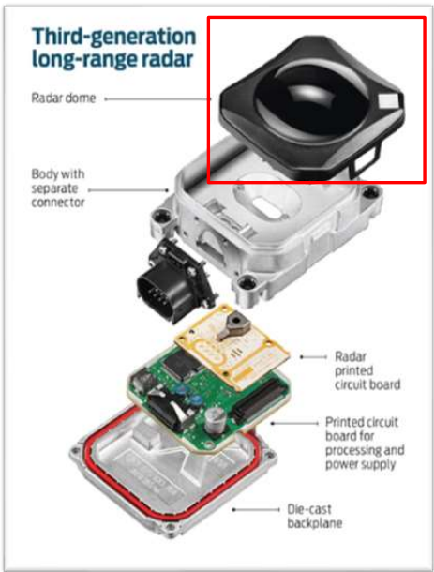
Inside an Automotive Radar
Protects radar from outer dust, water and harsh weather.Made with material which minimally attenuates the RF signal.
Case for the complete sensor which holds all the internal circuit and parts together. Provides protection to the sensor and allows the easy handling for people.
Contains multiple pins inside, where combination of certain pins are dedicated to each separate interface. Helps during predevelopment, testing and final production of sensor.
Includes Transmitting and Receiving antennas.
Analog in behaviour.
Digital part of the sensor.
Contains the power supply Unit for the sensor and other DSP electronics.
Part of the Radar case / Body.
Helps to protect Radar circuit and make it easy to handle.

Slide 13
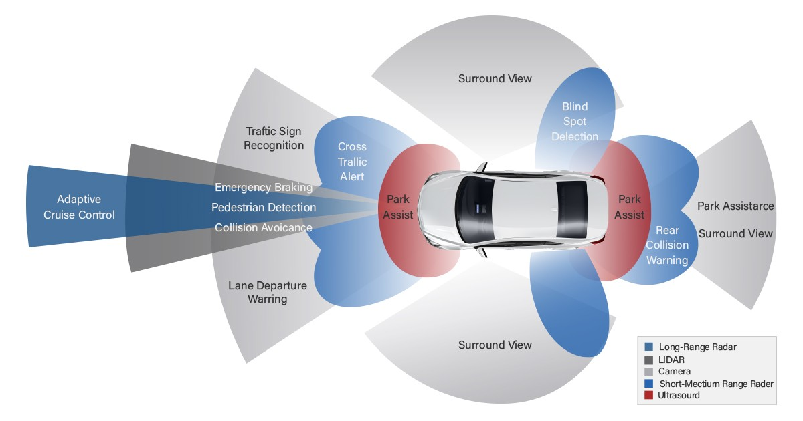
Radar Sensor on vehicle
Ego vehicle, target vehicle and coordinate system

Slide 14
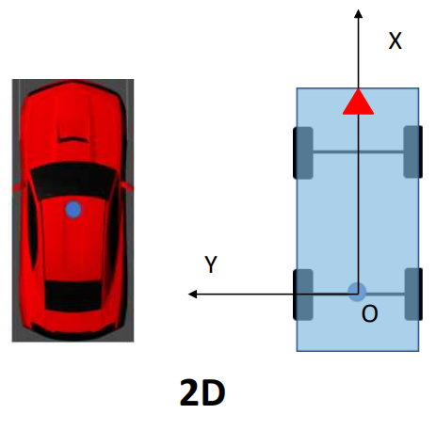
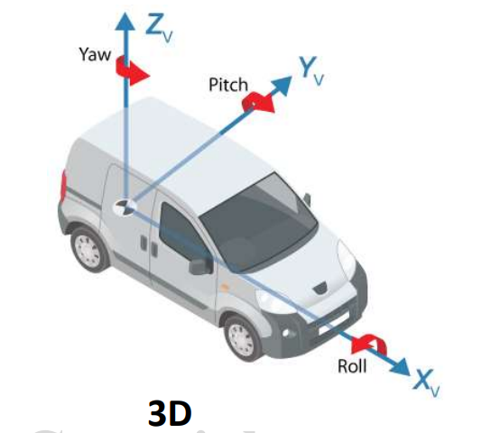
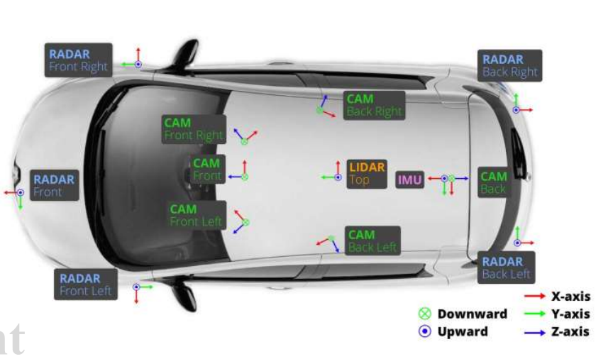
Sensor coordinate system
Need for ego coordinate system
We need one coordinate system which can be used as reference for measurement and comparison of all the sensor data.
Depending on application, we can use either only 2D system or 3D system of coordinates
Can be define in same manner as ego coordinate system.
The origin will be then the place on ego vehicle where sensor is placed.

Slide 15
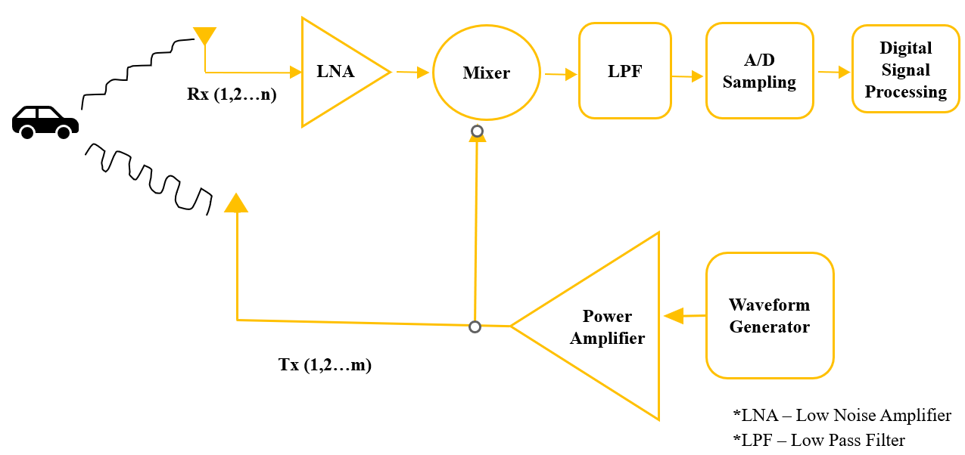
Components of Radar Signal Processing :

Slide 16
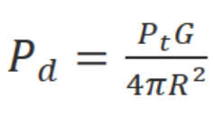
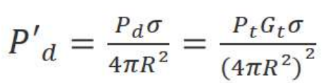
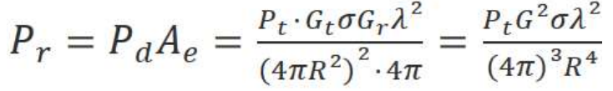
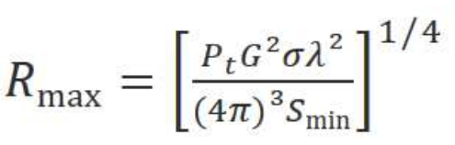
Radar Equation (Range) :
A radar equation relates the Range of a radar to the characteristics of *the transmitter, *receiver antenna, *target, and distance.
# Power density at the target is given by :
# Power density at the Radar is given by :
Pt - Transmitted power
G - Gain of Transmitting antenna
R - Distance of the target
σ - area / Radar cross section (RCS)
# Power received by the radar is :
# Maximum range that a target can be detected :
Ae - Effective area of radar antenna
Gr – Gain of Receiver antenna
Smin – min. detectable signal by radar

Slide 17
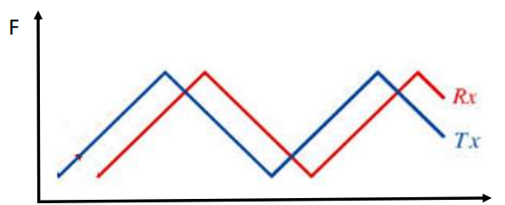
FMCW (Frequency Modulated Continuous Wave) :
Frequency Modulation – Changing frequency of the signal over time
It is signal in which the frequency of the signal increases or decreases linearly with time.
Increasing frequency – up ramp
Decreasing frequency – down ramp

Slide 18
Components of Radar Signal Processing :

Slide 19
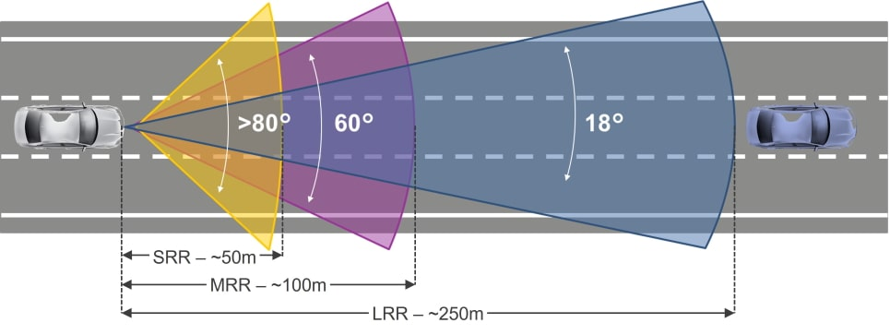
Sensor field of view
Total area covered by sensor, where it can detect the objects.
Main parameters which governs FoV of Radar Sensor are
Minimum and Maximum vertical Range
Minimum and Maximum Horizontal Angle

Slide 20
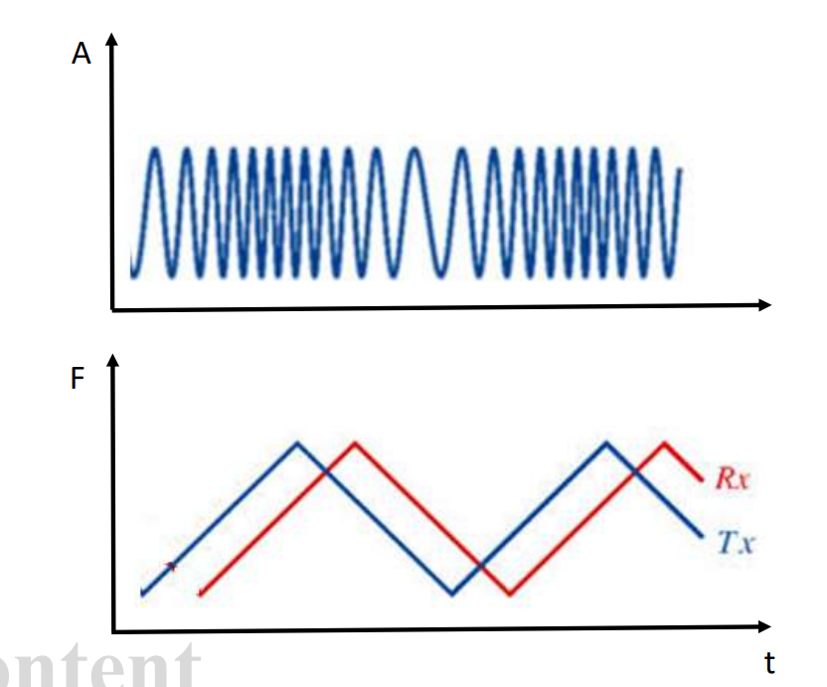
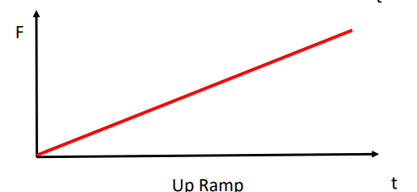
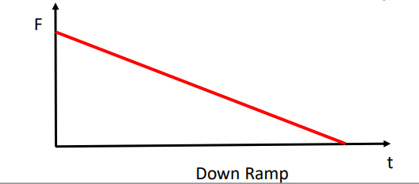
FMCW
- Frequency Modulated Continuous waveform
Triangular waveform
(Upramp and Downramp)
Sawtooth waveform
(Upramp or Downramp)

Slide 21
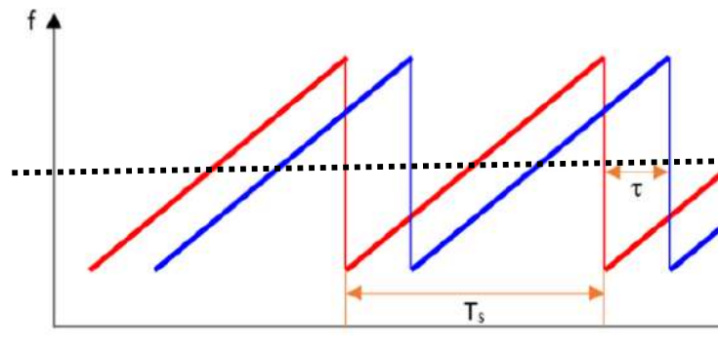
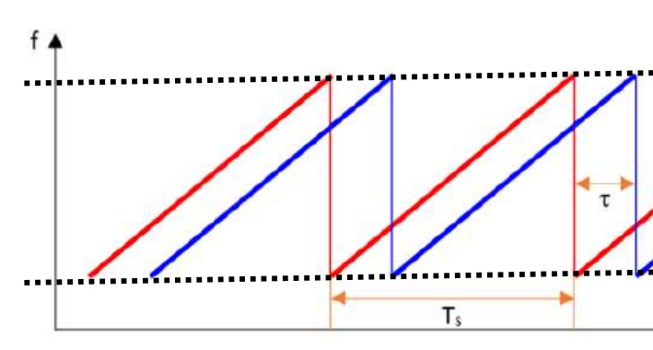
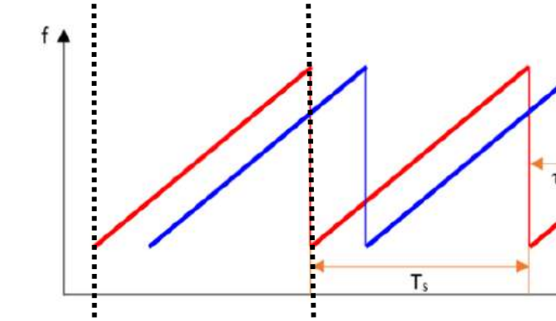
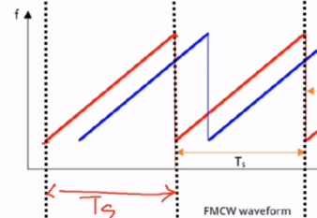
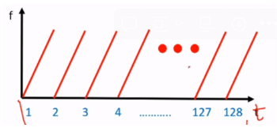
Carrer Frequency
Bandwidth
Chirp
Centre frequency between highest and lowest frequency component.
The difference between the highest frequency and the lowest frequency of the signal.
One complete Ramp is called chirp. One frequency sweep from lowest to highest frequency
Chirp Time (Ts)
Slope of the Chirp
Segment or One frame
Total amount of time taken to start of the chirp to end of the chirp
slope = delta(Y)/delta(X)
delta(Y) = Bandwidth (Fh - Fl)
delta(X) = Ts
therefore, slope = BW/Ts
Total number of chirps in one scan of the Radar sensor. It sends continuous chirps one after another

Slide 22
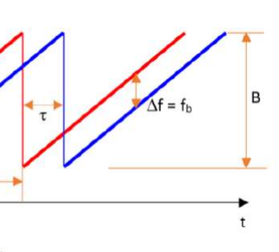
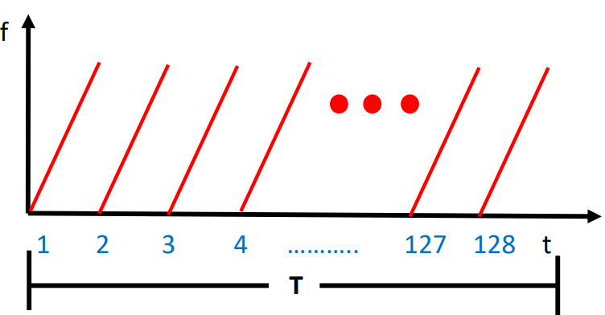
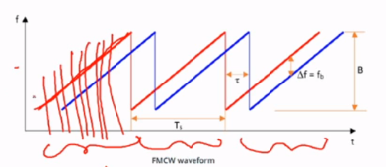
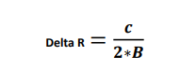
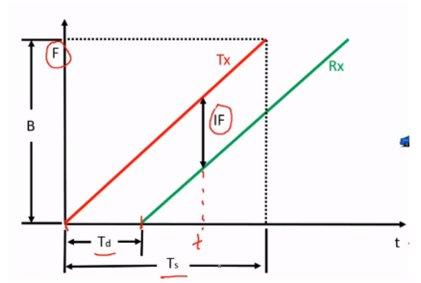
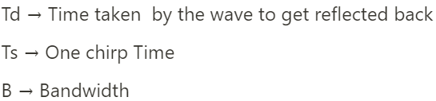
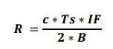
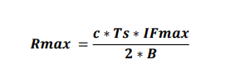
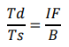
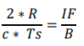
Time Segment
Intermediate Frequency
Chirp Sampling
One chirp time(Ts) * Number of chirp.
Difference between the transmitted signal and received signal frequency
Rx signal is sampled to covert it from analog to digital. The frequency at which the sampling takes place is called chirp Sampling
Measurement of Range
Resolution
;
;

Slide 23
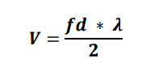
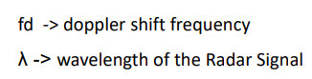
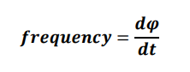
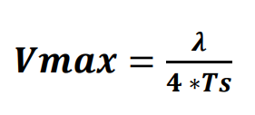
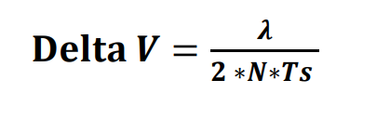
Measurement of Velocity
Radar uses the principle of Doppler shift to measure the velocity
The apparent change in the frequency of the wave due to the relative motion of the source and the observer is called Doppler shift.
IF = f1(distance) + f2(doppler shift) , but in automotive radar f2<<<<<f1, so f2 is discarded and can’t be calculated using IF.
We need to calculate the phase change of the two consecutive chirps
Maximum Velocity formula
Resolution
More no. of chirps -> High resolution

Slide 24
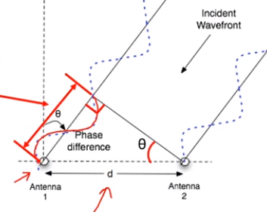
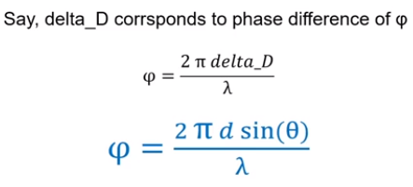
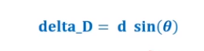
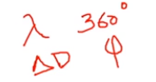
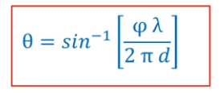





Measurement of Angle
AoA :Phase difference between the two Rx signal receiver by Rx antenna.
Maximum Angle :
Resolution

Slide 25


Measurement of RCS
Radar : It sends out radio waves.
Object : It could be of any shape and size, it reflects back some of the radio waves back to the radar.
So, Radar cross section is a way to describe how visible an object appears to radar, based on the shape and size.
Factors : Surface, shape, Material, Tx frequency etc.
RCS Large object > RCS small object
Corner Reflector : It is a retroreflector used for Radar testing and calibaration, consisting of three perpendicular intersecting flat surfaces

Slide 26


Clutter
Unwanted reflection points in Radar Measurement is Clutter
Sources:
Ground Reflection.
Nearby Static objects which are not consider as valid target objects.
Rain, fog, some particles in air, etc.

Slide 27
why to remove Clutter ?
Unwanted reflection points in Radar Measurement is Clutter.
Clutter adds to a lot of extra measurements which is Unwanted.
Considerably decrease the useful information /feature extraction at higher level of processing.
Can lead to false activation of vehicle actuators during driving.
Example: Reflection from ground falsly detected as from vehicle, and ADAS brakes the vehicle for safety
How to remove Clutter ?
Every Radar Reflection has Magnitude / Received Power.
Use some threshold to filter based on this value

Slide 28

Why Clutter Removal is Complex ?
Low Constant Threshold to filter.
- May not remove all clutter
High Constant Threshold to filter.
- Can lead to removal of some valid reflections / detection points

Slide 29

Dynamic / Adaptive Thresholding : CFAR
Varying the threshold value to.
Filter most possible clutter.
To maintain most possible detections

Slide 30


AFTER CFAR (Clutter removal) and FINAL LIST DETECTION

Slide 31


FMCW Frame
When Radar scans one time the complete FoV (say +/- 45 degree), it means it processes one complete FMCW Frame which consists of multiple chirps.
Processing one complete frame provides radar measurements (multiple detections) of one radar scan.

Slide 32



FFT (Fast Fourier Transform)
If we got a raw signal then we can’t do anything with it, in order to extract any information and other signal components we need fourier transform.
It simply converts the time domain signal to frequency domain signal and vice versa.

Slide 33


Slide 34


Slide 35

Automotive Radar Data Processing
Section -6 Part I
Coordinate Transformation
Ego vehicle motion compensation
Separation of Dynamic and Static detections

Slide 36

Image source : https://www.udemy.com/course/automotive-radar-basics-to-advance
Detection | Range (m) | Velocity (m/sec) | Angle (degree) | RCS | Other Parameter
1 | 20.5 | -6.5 | 10 | * | *
2 | 36 | 0.5 | 20 | * | *
… | …….. | …….. | …….. | ……. | ………………….

Slide 37


Ego vehicle motion compensation
Relative vs Absolute velocity
-90m/s
-50m/s
40m/s
Relative velocity = VB - V A
VAB = -90m/s (Doppler relative velocity)
Detected by the radar
Absolute velocity = VAB + V A
VB = -50m/s (Absolute velocity)

Slide 38

Coordinate Transformation
Transformation from Polar to Cartesian Coordinates:
x=r⋅cos(θ)
y=r⋅sin(θ)
Where:
r is the range (distance from the radar to the target),
θ is the azimuth angle (angle in the horizontal plane).
3D Transformation (Including Elevation):
z=r⋅sin(ϕ)
Where:
ϕ is the elevation angle.
Image source : Stochastic Geometry Methods for Modeling Automotive Radar Interference

Slide 39

Transform Sensor – Ego vehicle
P’(r’,θ’) is the distance from Sensor reference.
x’ = r’⋅cos(θ’)
y’ = r’⋅sin(θ’)
P(r,θ) is the distance from Ego vehicle reference.
x = r⋅cos(θ) + r’⋅cos(θ)
y = r⋅sin(θ) + r’⋅sin(θ)
R^2 = x^2 + y^2
Where:
R is the range (distance from the ego point to the target),
θ is the azimuth angle (angle in the horizontal plane for ego point).

Slide 40
Transform – Sensor to Ego Vehicle
Radar Detection before Transform | Radar Detection after Transform
Range (in sensor coordinates) | X in ego vehicle coordinates
Angle (in sensor coordinates) | Y in ego vehicle coordinates
Doppler Relative Velocity | Doppler Absolute Velocity
RCS | RCS
…………….. | ……………..

Slide 41

Filtering of Dynamic and Static Detection
In ADAS and in AD, we are interested in all the moving objects around vehicle
To avoid collisions, and other danger situations
Only detections from moving objects are required to process
Filter using absolute Velocity of the detections
Absolute Velocity contains velocities only above certain threshold – say > (+/- 0.5 m/sec) - Dynamic
Image source : Mobileye & WNC collaborate on imaging radar | Mobileye News

Slide 42

Clustering and Feature Extraction

Slide 43

Feature Extraction Table

Slide 44



Single Object Tracking

Slide 45



Multi Object Tracking

Slide 46

Prediction And Measurement Cycle

Slide 47

Data Allocation In Mot

Slide 48
Thank You!

